Slide 1
Lab 2: Exploring Data with Graphical Displays and Numerical Summaries “Got Data”
STAT 201: Elementary Statistics
Shan Zhong

Slide 2
Introduction to the lab
The purpose of this lab is to get familiar with working with the data in StatCrunch.
This lab illustrates how software can be used to work with large amounts of data.
We are going to be working with the data that has been created from the survey that all 201 students were asked to complete.
We are going to use this data to create graphs and make observations from these graphs.
Table 2.1 is a good reference for which types of graphs can be used with each type of data (categorical vs quantitative).
We are going to create numerical summaries using this data.
Table 2.1 is a good reference for which types of numerical summaries can be used with each type of data (categorical vs quantitative).

Slide 3
Steps for Lab 2
Log on to the computer.
Go to StatCrunch.com:
( Or Explore -> Data -> USC STAT 201 Fall 2016 Thursday/Friday )
Follow the instructions on page 13 and 14 (the pages can be found in the Blackboard Lab 2 folder) and answer all the questions that follow. Several of the questions have multiple parts so make sure you answer everything.
Make sure you try to find all options to create graphs and numerical summary before asking for help (use trial and error).
Some fine points to be followed—
Each student must turn in their own work.
On the word document, please include your name and section.
Please label each question with the correct number to make grading easier.
You may minimize the graphs so you aren’t using too much paper.
https://www.statcrunch.com/app/index.php?dataid=1878467

Slide 4
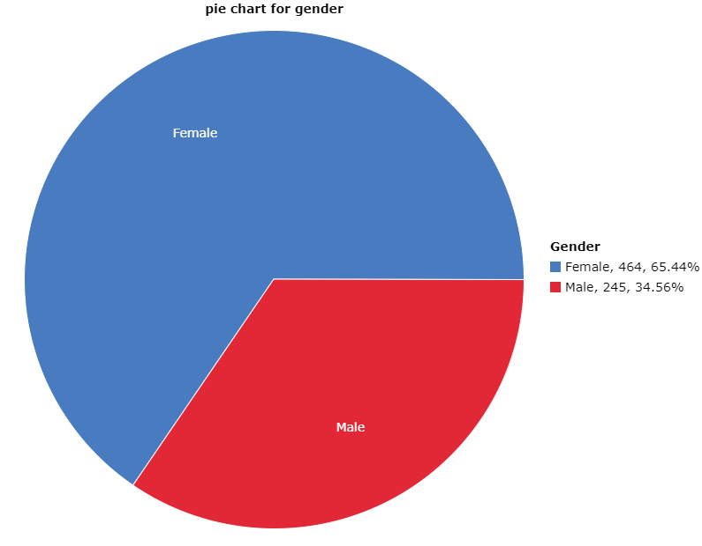
Categorical vs Quantitative Review
1. One categorical variables Example:
Graph: Graph->Pie Chart->With Data-> Choose Gender in Select columns -> Compute
2. Choose another categorical variable, make a graph and save it in a word document, write one sentence to describe your observation.

Slide 5
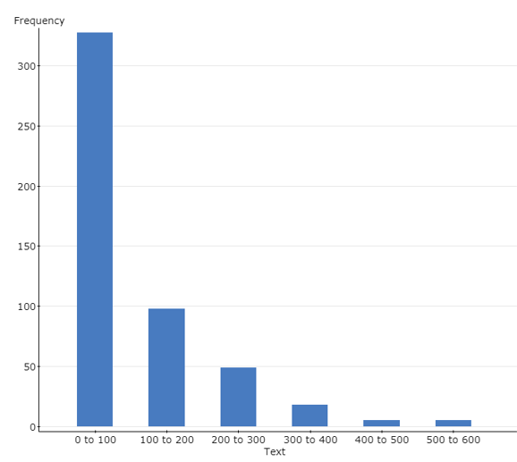

One quantitative variables:
Graph->Histogram->text->compute
Stat-> summary stats->columns->text->compute
Choose another quantitative variable, make a graph and save it in a word document, write one sentence to describe your observation.
How many text messages do you send per day?
For Students who take STAT 201:

Slide 6
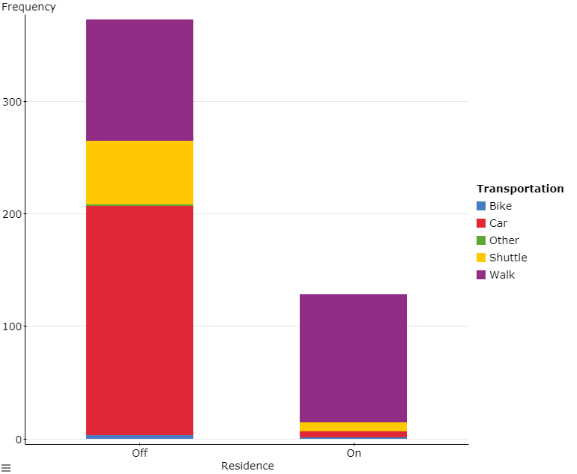
3.Two Categorical variables:
Students who take Fall 2018 STAT 201:
Graph->Bar plot->with data-> select column gender-> group by transportation-> stack bars->value above bar->compute
Choose other variables and make a graph, save it in a word document, write one sentence to describe your observation.

Slide 7
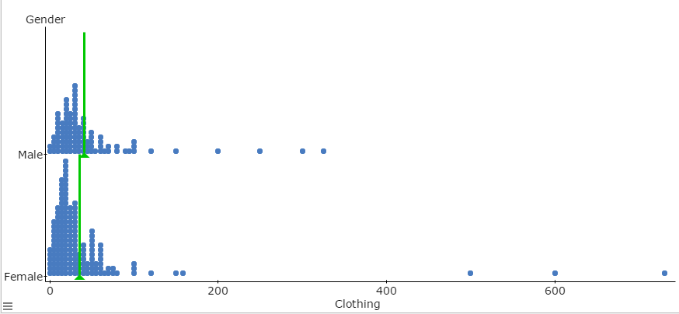
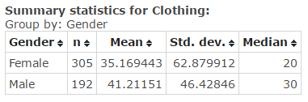
4.One quantitative and one Categorical variables:
How much does students spent on clothing
Graph->dotplot- select column clothing-> group by gender-> marker mean->compute
Stat-> summary stats->columns->clothing -> group by gender->compute
make a similar graph with other variables, save it in a word document, write one sentence to describe your observation.

